Slide 1


Introduction To
Headless Drupal
Salman Jaffery
DrupalCamp Montreal 2014

Slide 2

Salman Jaffery
Developer at ColdFrontLabs Inc.
Over 7 years development experience
sjpeters79

Slide 3
Headless Drupal: Agenda
What is Headless Drupal?
What are it’s benefits and drawbacks?
Demo!!!

Slide 4



What is Headless Drupal?
It’s Drupal where the head / theme is missing.
Drupal becomes RESTFUL service oriented
Free to use popular JS Frameworks

Slide 5
What is Headless Drupal?
Static Web
CMS Web
Headless Web
Database of Content
Database of Content
Static HTML
PHP logic renders HTML
PHP logic controls access to data
JS fetches data, render HTML
Browser
Browser
Browser
Notes:
A normal static site involves back and forth communication between a server and client.
Drupal and other content management systems handle content management with use of a data source and provide the content in rendered entity back to the client browser.
Headless Drupal on the other hand does same thing but instead of providing a rendered entity, it provides services to retrieve data which is then rendered by a another source before being sent to the client browser. What this basically allows is for a service driven approach where by one headless drupal instance could be providing data for several applications. For example I could have a website and a mobile application using the same drupal api to retrieve and add content.

Slide 6
Headless Drupal Trends
Service oriented instead of HTML oriented
Decouple drupal back end from user facing front end
Drupal should output API instead of HTML
Notes:
Headless Drupal focus is to have Drupal become a service oriented system instead of rendering HTML content.

Slide 7
Headless Drupal: Benefits
Free front end developers
More responsive and quicker sites
Build interactive sites
Notes:
The first major benefit right off the bat is that front end developers no longer have to figure out how to style what drupal renders, they are basically free to design how they imagine the information should be presented. And when it comes to redesigning your site again in the future, it’s much easier to do so rather than to use Drupal’s in build editor tools.
This in turn leads to more responsive sites and because they built using modern js libraries like angular or node js and others, the sites are much quicker to load. There’s no complex drupal rules to process before a node is rendered. Everything just works seamlessly especially with ajax calls, we can build seamless and interactive sites.
To sum up, headless website development has the potential to unleash the creative power of front-end developers to deliver faster, more responsive, and richer user experiences.

Slide 8
Headless Drupal: Drawbacks
API drawbacks
Migration to Drupal 8
Notes:
Like any other rest api, the drawbacks here linger around any api drawback from badly designed api where there are too many http requests to fragmentation, etc. When we are using headless drupal, it’s basically a service provider so it depends on how it’s setup.
Drupal 8 is said to have a superior rest api client and as such when it does finally come out, we’ll need to migrate the services to drupal 8 which can be done but will be a little tricky depending on how you’ve setup your services.

Slide 9
REST: What is it?
Representational State Transfer (sometimes spelled ReST)
RESTful applications use HTTP request to GET, POST, PUT, and DELETE data
Notes:
REST stands for representational state transfer which basically means that this a server architecture that is stateless and a lot of other which if I get into will take too long to explain but what you should get from it is that it basically gives a limited number verbs that we can use to specify the functionality that our services will have.

Slide 10
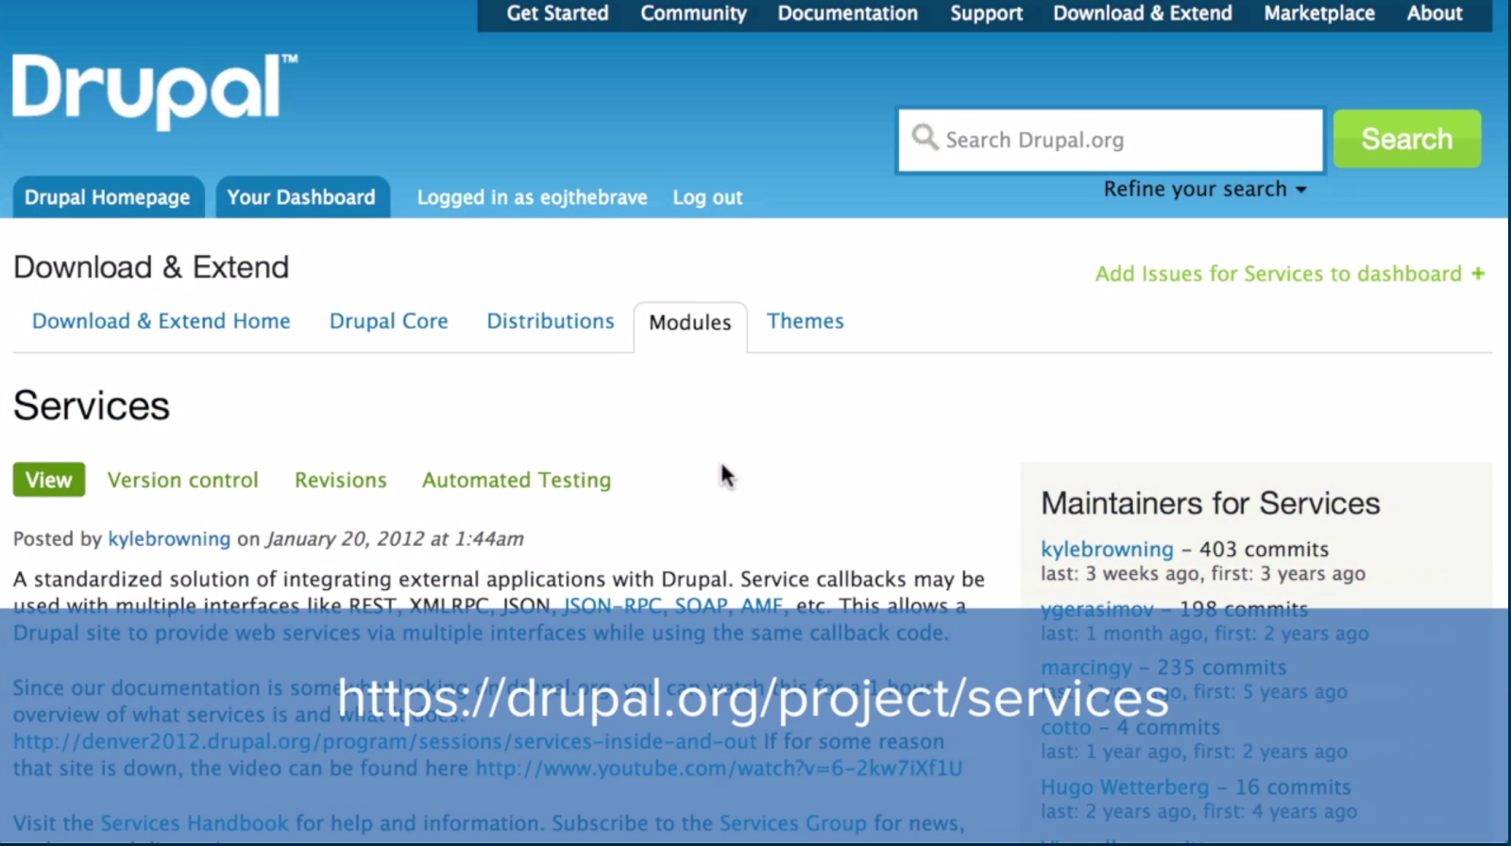
Notes:
Services module allows us to create an api using web services. The service module provides a basic framework which exposes application functionality and data within a drupal site as a service. It handles some of that for us. Like nodes, taxonomy, users and comments can be retrieved, updated, etc with an issue. But this module also allows us to add custom services as well.
We can download this module from drupal.org and place it within our contrib module directory.

Slide 11
Demo!!!
Installing Service Module
Create an endpoint
Retrieve some data using rest chrome plugin
Notes:
Ok so now demo time.
This is going be a basic example of how to use drupal as service provider.
We’re gonna look at the services module within drupal 7 and create endpoint which basically retrieves a bunch of nodes and display them via a get request through the rest console chrome extension.
We’ll start off with enabling the service module.
For this demo I’ve already gone ahead and installed the services module, so now we will enable the it module as well as a the rest server module. We also enable the devel generate module to generate some dummy content that we’ll be using for this demo.

Slide 12


